Slide 1
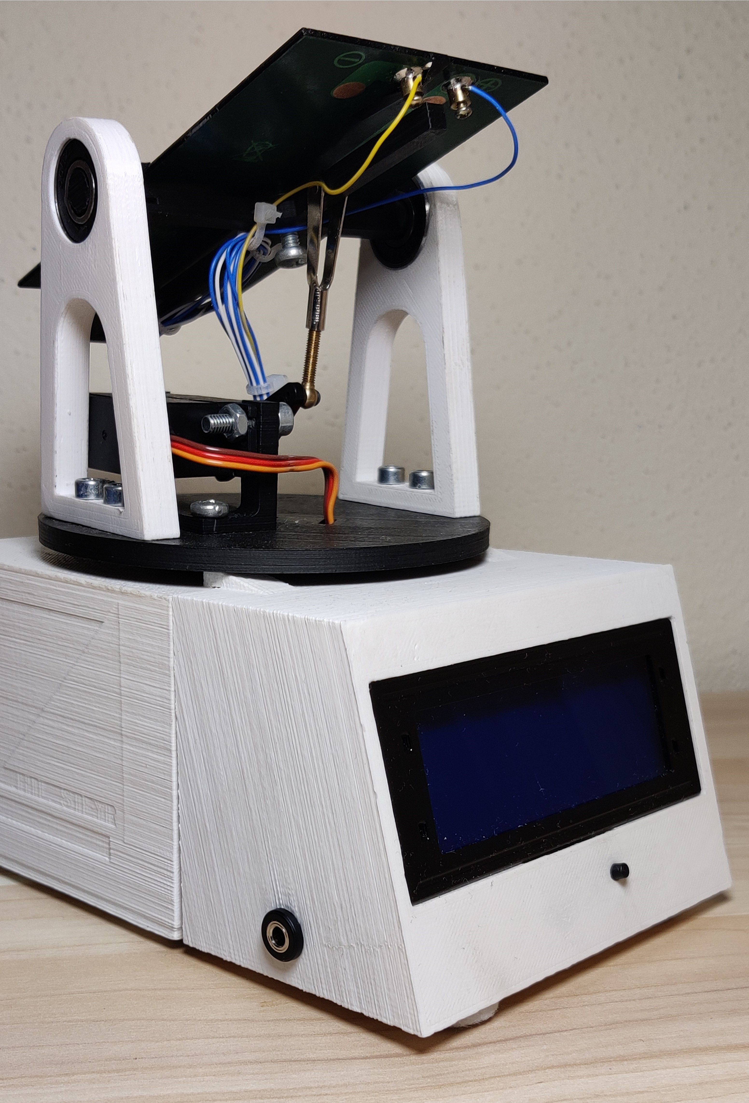
Solartracker
By Patzelt, Templ und Köglberger

Slide 2
Faced Problems
-Power supply
-LCD-Case mounting
-Construction of the Gears
-Servo Movement
-Wiring
-AD-Converter

Slide 3
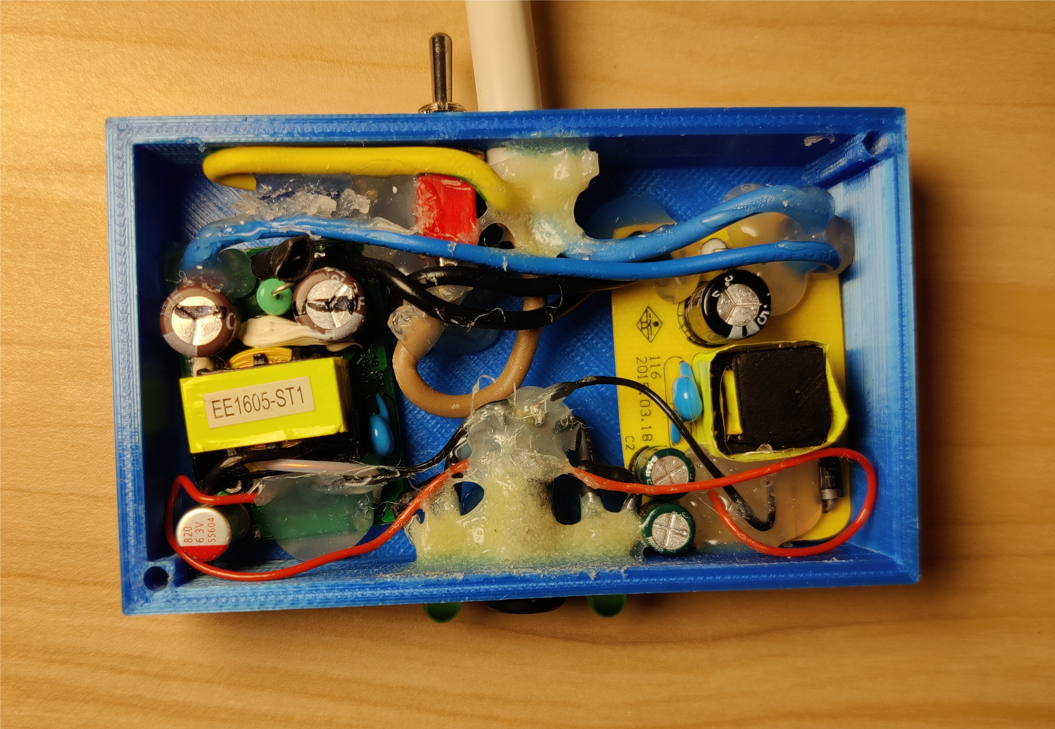
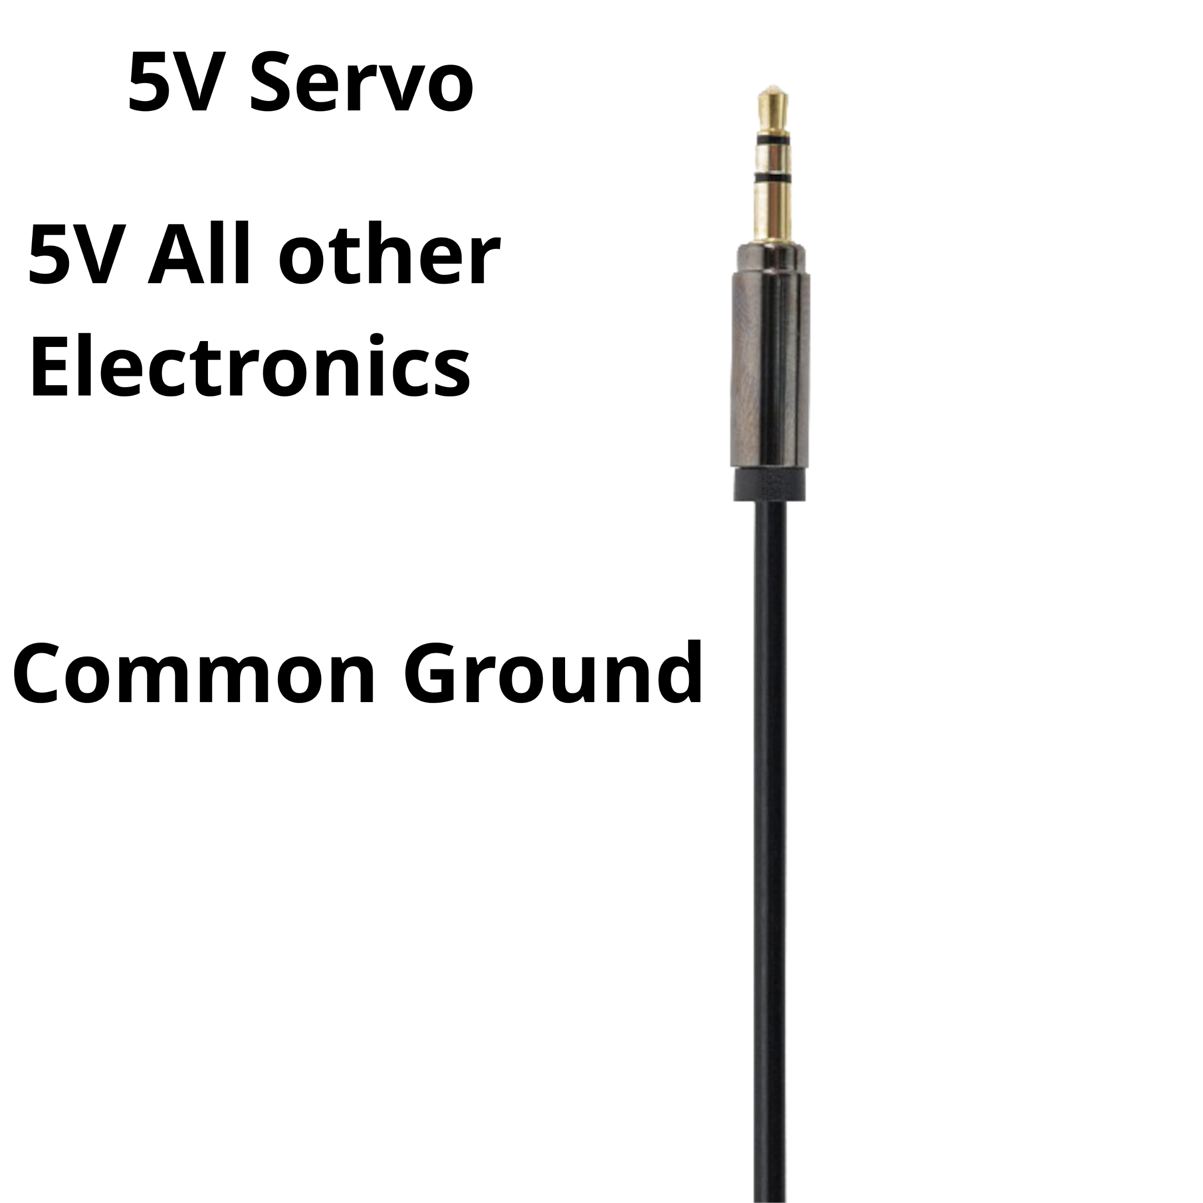
Power Supply
The servos need to much current, so the voltage would drop to a level where the Arduino would reset itself.
- The voltage drops too much to use only one power supply

Slide 4
LCD-Case mounting
-

Slide 5
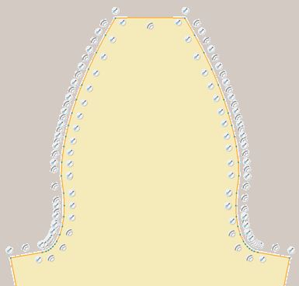
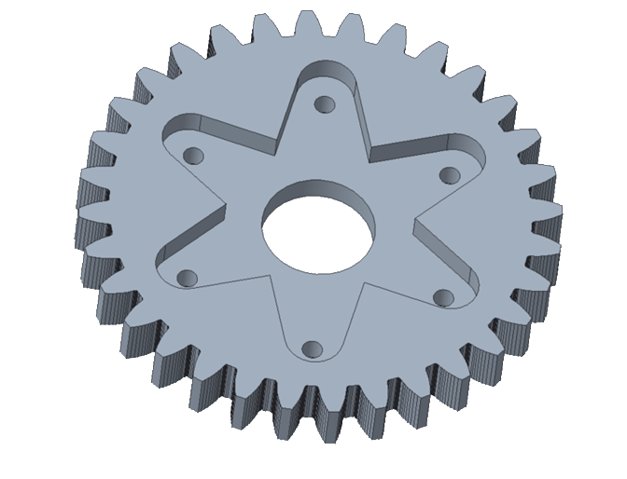
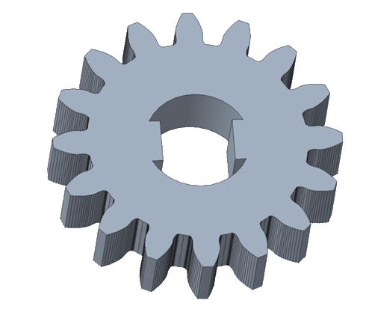
Construction of the Gears

Slide 6
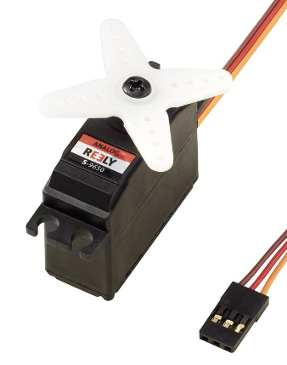
Servo Movement
-The servos were advertised to move from 0-180°, but they do not fully reach these promises

Slide 7
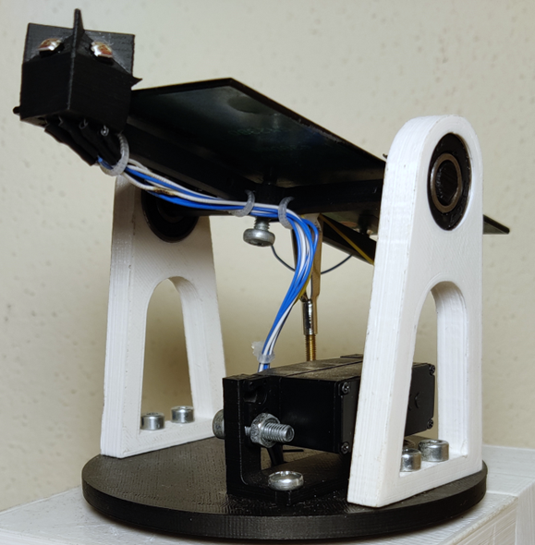
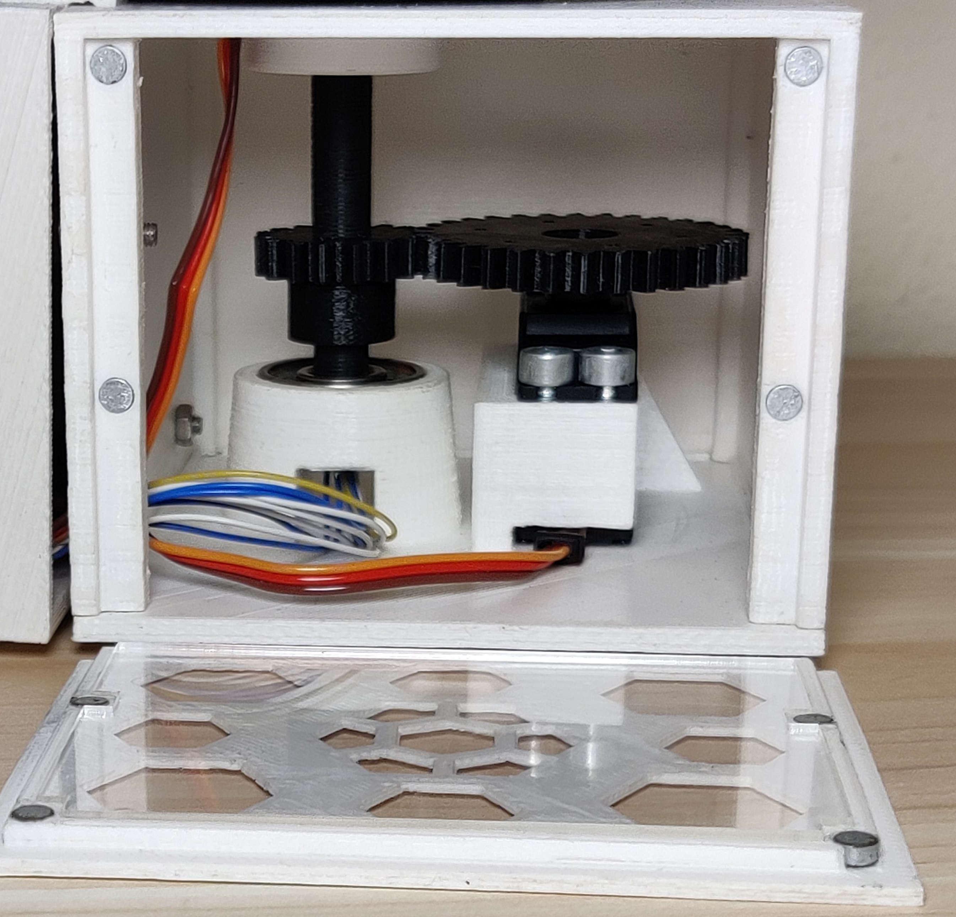
Wiring
-It was laborious to wire the LDR cables through the shaft
-Splitting the measuring wires from the servo wires

Slide 8
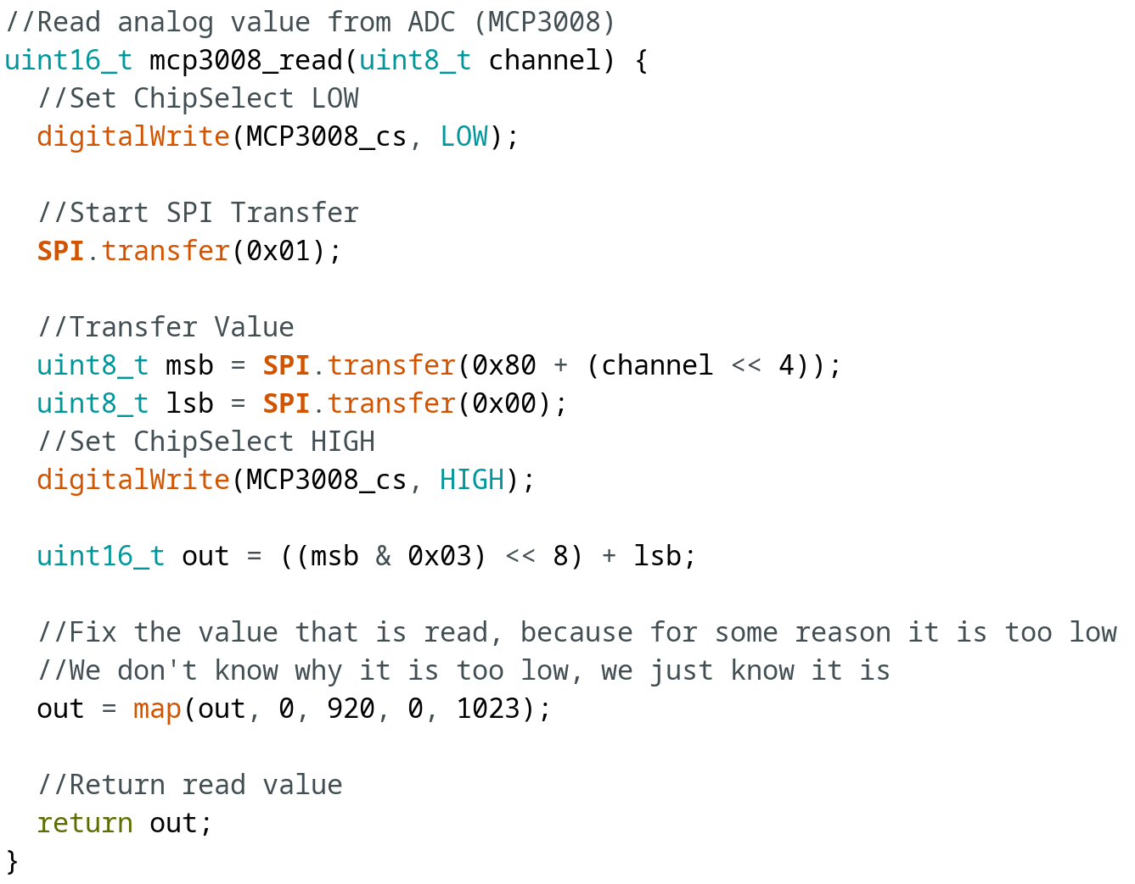
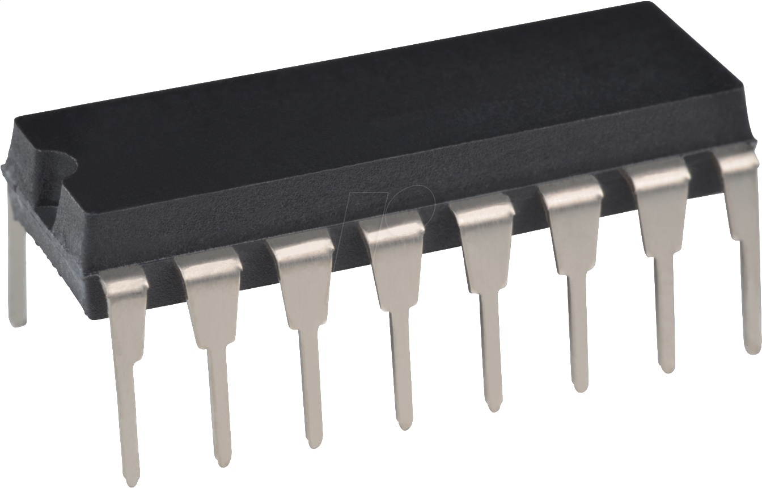
AD-Converter

Slide 9
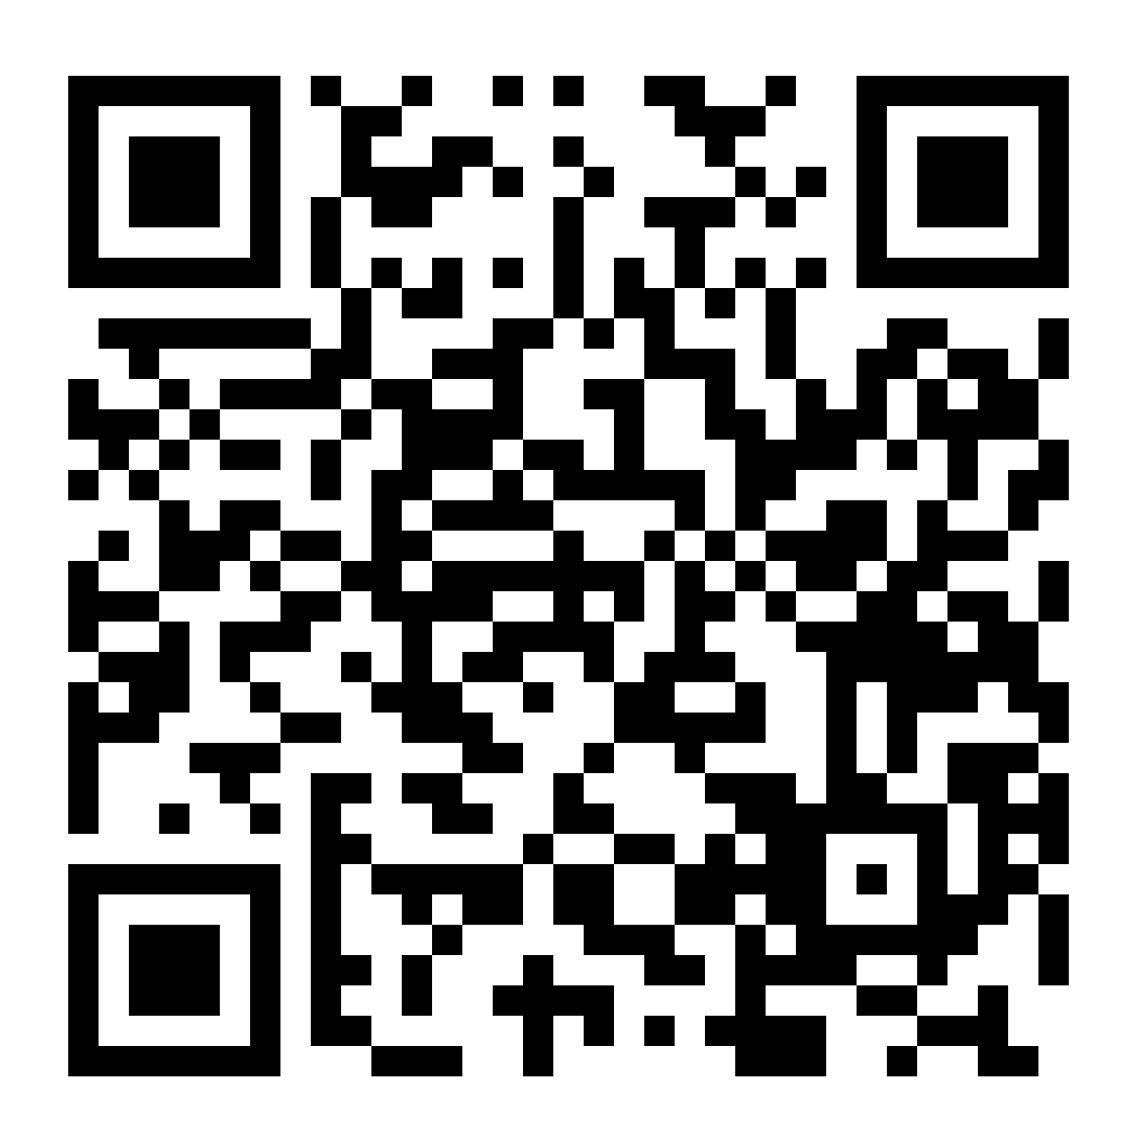
Repository
https://github.com/PatzminiHD/KOP_Solartracker

